Slide 1
Say Goodbye to Physical Mice : Introducing the AI Virtual Mouse

Slide 2

Introduction
The need for an AI virtual mouse
How an AI virtual mouse works:
Features and benefits
Comparison with other mouse devices
Future Developments
Screenshot
Conclusion

Slide 3

Introduction
An AI virtual mouse is a computer program that uses artificial intelligence and machine learning algorithms to interpret hand movements and translate them into cursor movements on a screen.
Purpose of the presentation: The purpose of this presentation is to provide an overview of the technology behind an AI virtual mouse, as well as the advantages it offers over traditional mouse devices.

Slide 4
The need for an AI virtual mouse:
Challenges with traditional mouse devices: Traditional mouse devices can be difficult to use for people with disabilities, repetitive strain injuries, or other physical limitations. Additionally, traditional mouse devices require a flat surface to work on, which can limit their portability.
Advantages of an AI virtual mouse: An AI virtual mouse does not require a physical mouse device, making it more accessible and convenient to use. Additionally, the use of AI and machine learning algorithms can improve the accuracy and responsiveness of the cursor movement.

Slide 5
How an AI virtual mouse works:
An AI virtual mouse uses sensors and algorithms to detect and interpret hand movements, including the position, velocity, and acceleration of the hand. These sensors can include cameras, infrared sensors, and depth sensors.
The data collected by the sensors is processed using machine learning algorithms, which can learn to recognize specific hand gestures and movements. This allows the AI virtual mouse to accurately interpret the user's intentions and translate them into cursor movements on a screen.

Slide 6

Features and benefits:
AI virtual mice can offer a range of features, such as the ability to recognize specific hand gestures or movements, customizable settings to suit individual preferences, and compatibility with a range of devices and platforms.
AI virtual mice can improve accessibility for people with disabilities or physical limitations, as well as increase productivity by allowing for more natural and intuitive control of a computer.
Features

Slide 7
Comparison with other mouse devices:
Comparison of an AI virtual mouse with traditional mouse devices and other alternative mouse technologies: AI virtual mice can be compared to traditional mouse devices, touchpads, and other alternative mouse technologies such as touchscreens and trackballs.
Advantages and disadvantages of each: Each mouse technology has its own advantages and disadvantages, such as ease of use, accuracy, and accessibility.

Slide 8
Future Developments:
Overview of potential future developments in AI virtual mouse technology: Future developments in AI virtual mouse technology could include improved accuracy and responsiveness, more natural and intuitive control, and greater compatibility with a range of devices and platforms.
Predictions for how the technology may evolve over time: As the technology behind AI virtual mice continues to evolve, it is likely that they will become more widely adopted and integrated into various applications and devices.

Slide 9
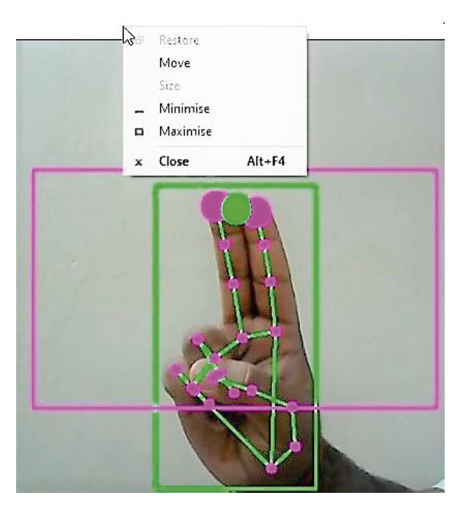
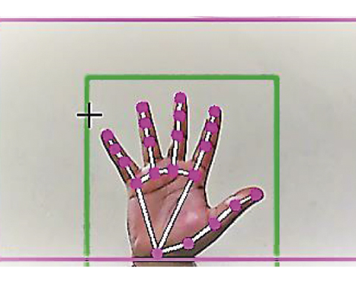
Screenshot

Slide 10
Recap of the key points discussed in the presentation: The use of AI virtual mice can provide a range of benefits over traditional mouse devices, including improved accessibility and increased productivity.
Final thoughts on the importance of AI virtual mouse technology: As technology continues to evolve, it is important to explore new ways of interacting with devices and applications, and AI virtual mice offer a promising alternative to traditional mouse devices.
Conclusion

Slide 11




Thank you

